Slide 1
South Carolina Legends
Septima Poinsette Clark
&
Bernice Violanthe Robinson

Slide 2
Septima Poinsette Clark
Charleston, SC Native

Slide 3
Septima Clark
Her fight for the African American community started In Charleston South Carolina and spread across the southeast.
Clark taught at black school on John’s Island, South Carolina for over 30 years, educating African American people in the community.
She is largely responsible for helping start the school that taught voting aged African Americans to read so that they will be able to vote.

Slide 4
Septima Clark
Member of the National Association for the Advancement of Colored People (NAACP)
While teaching on John’s Island, the state legislature banned employees of the state from associations with civil rights groups.
Clark refused to denounce her membership with the NAACP and was forced to leave her teaching position.

Slide 5
Septima Clark
Attended Highlander Folk School, where white and black people from across the nation would gather and discuss what needed to be done in their communities, and their communities were facing when it relates to race.
Highlander was a safe space for these conversations

Slide 6
Bernice Violanthe Robinson
Charleston, SC Native

Slide 7
Bernice Robinson
Born February 7, 1914
Septima Clark’s first cousin
Also largely responsible for the civil rights movement in the South.

Slide 8
Bernice Robinson
Attended Highlander Folk School with Septima Clark
Recognized as a key figure in the education of black citizens in the South.
Helped hundreds of African Americans learn to read and write in order to vote in the primary elections from which black citizens were previously not allowed to vote or could not vote in because they could not read and write.

Slide 9
Bernice Robinson
Member of the NAACP
Member of Alpha Kappa Alpha Sorority Inc.
Worked as a beautician when she returned to Charleston after living in New York City, so that she could make money and do work for the NAACP without fear of losing her job or having financial issues.

Slide 10
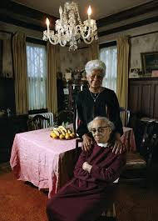
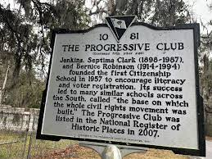
Bernice Robinson(standing)
Septima Clark(seated)
The Progressive Club historic site for the school where they taught African Americans to read, write and comprehend the laws and constitution. These acts of boldness prepared African Americans to vote and on of the reasons the civil rights movement started in the south.

